Slide 1
Web Application Security Testing the OWASP style
John Vargas – Michael Hidalgo
7th WCSQ Lima, Perú 2017

Slide 2

About us
Michael Hidalgo
Software Engineer and Application Security Expert.
Based in San José, Costa Rica.
Leader OWASP Costa Rica
John Vargas

Slide 3
Agenda
Overview of the HTTP Protocol and Web Technologies
Web Application (In)Security
Mapping the Application
Client-Side Validations Bypass
Common Web Application Vulnerabilities.

Slide 4
Overview of HTTP Protocol and web technologies

Slide 5
The HTTP Protocol
Hypertext Transfer Protocol is the core communication protocol used to access the WWW.
Uses a message-based model where a client sends a request and the server returns a response message.
HTTP is an application layer protocol: It relies on TCP protocol for transport.
HTTP is a stateless protocol.
RFC 2616 "Hypertext Transfer Protocol HTTP/1.1", 1999 @ http://www.ietf.org/rfc/rfc2616.txt.

Slide 6
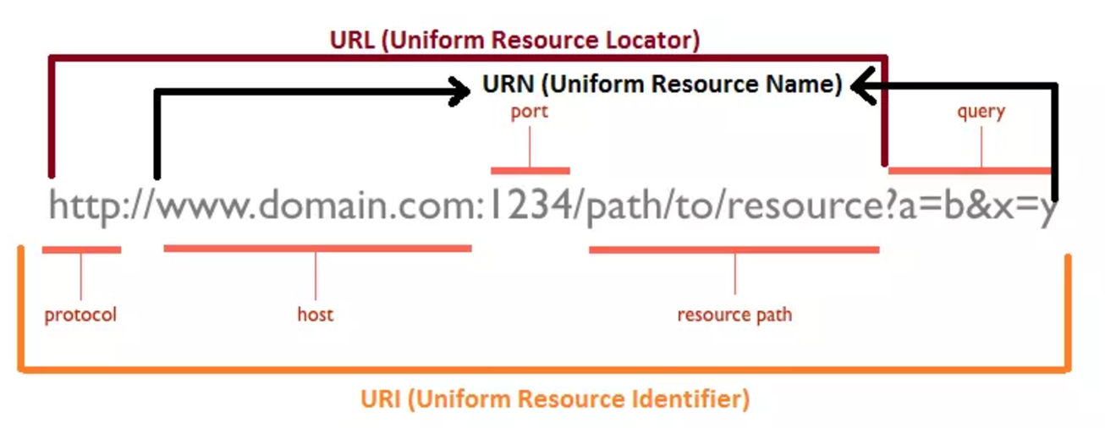
URL, URN, URI: Oh My!
Image taken from: http://webtechsharing.com/http-web-developer-must-know/

Slide 7
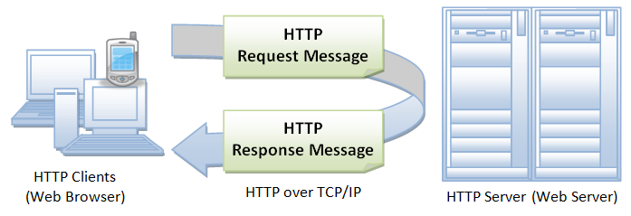
HTTP Illustrated
Image taken from https://www.ntu.edu.sg/home/ehchua/programming/webprogramming/HTTP_Basics.html

Slide 8
General HTTP Headers
Connection: Tells the other end of the communication where it should close the TCP connection
Content-Encoding: Specifies what encoding is being used for the body of the message (e.g gzip).
Content-Length : Specifies the length of the message body in bytes.
Content-Type: Content type contained in the message body.

Slide 9
HTTP Request
HTTP request consist of three items separated by spaces:
HTTP Verb : Indicates the HTTP Method.
Requested URL : URL is the name of the resource being requested.
HTTP version being used.
HTTP Headers:
Referer
User-Agent
Host
Cookies.

Slide 10
Request HTTP Headers
Accept: Tells the server what kinds of content the client is willing to accept.
Accept-Encoding: Tells the server what kind of content encoding the client is willing to accept.
Authorization: Submit credentials to the server.
Cookie: Submit cookies to the server.
Host: Specifies the hostname of the URL.
User-Agent: Browser or client performing the HTTP request.

Slide 11
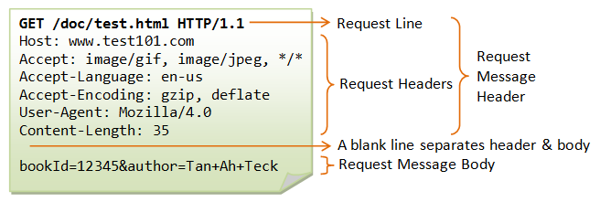
Example HTTP Request
Image taken from https://www.ntu.edu.sg/home/ehchua/programming/webprogramming/HTTP_Basics.html

Slide 12
HTTP RESPONSE
HTTP request consist of the following elements:
HTTP version being used.
Status Code : A numeric value indicating the result of the request.
Server header.
Set-Cookie
Content Length.

Slide 13
Response HTTP Headers
Expires: Tells the browser for how long the content of the body message are valid.
Pragma: Cache directives
Set-Cookie: Issues cookies to the browser
X-Frame-Options: Indicates whether and how the current response may be loaded within a browser.

Slide 14
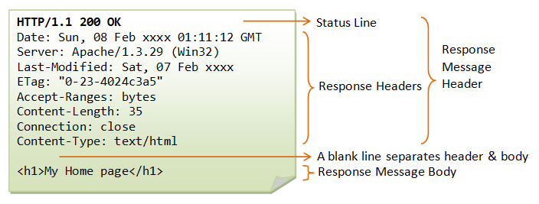
Example HTTP Response
Image taken from https://www.ntu.edu.sg/home/ehchua/programming/webprogramming/HTTP_Basics.html

Slide 15
HTTP Methods

Slide 16
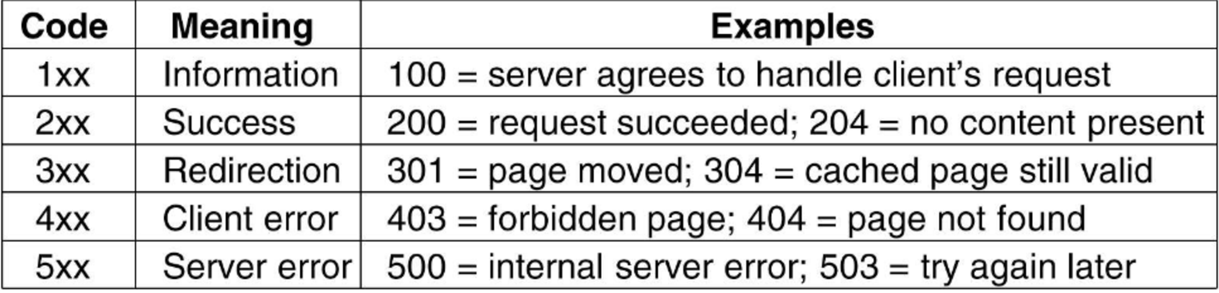
HTTP Status Codes

Slide 17


Slide 18
State Management with Cookies
HTTP Is a Stateless Protocol : The request contains all the necessary information for the server to return a response.
With Cookies, the server sends items of data to the client, which the client stores it and resubmits it.
Servers issue a cookie using the Set-Cookie HTTP header.
Frequently used as a vehicle for exploiting vulnerabilities.

Slide 19
Anatomy of a Cookie
Expires: Sets a date until which the cookie is valid.
Domain: Specifies the domain for which the cookie is valid.
Secure: When this attribute is set, the cookie will be submitted only in HTTPS.
HttpOnly: When this attribute is set, the cookie cannot be accessed from Client Side code (a.k.a JavaScript).

Slide 20
Web application (IN)Security

Slide 21
Core Problem : Input Data Validation
URL
Form fields
GET Parameters
POST Payloads
HTTP Headers
Web Services
Cookies
External Services
Database

Slide 22
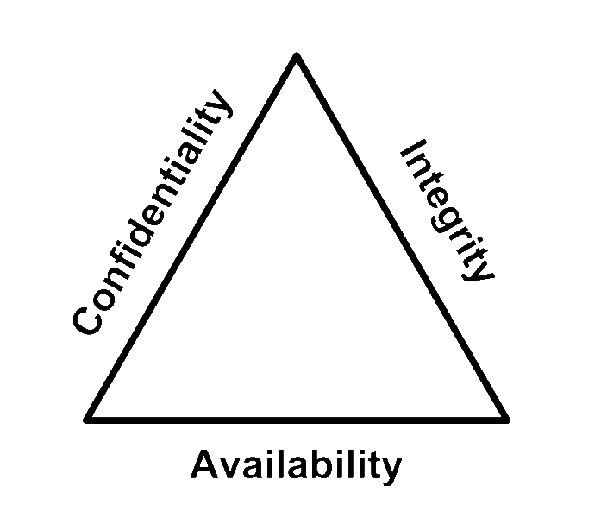
CIA Triad

Slide 23

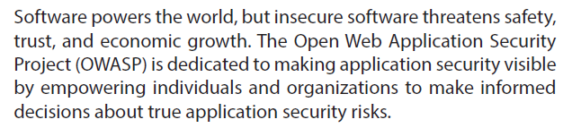
Who is OWASP?
Notes:
OWASP is a global community that drives the visibility and evolution in the safety and security of the world’s software.
Everyone is free to participate in OWASP and all of our materials are available under a free and open software licenses.
OWASP is a registered nonprofit in the United States and Europe, so all of your financial contributions are tax deductible.

Slide 24
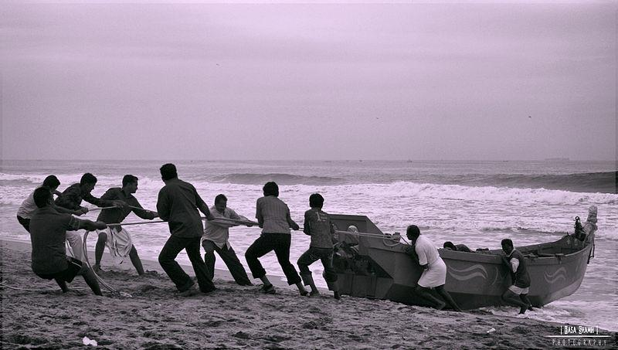
The value of volunteerism
Notes:
A recent survey carried out by TimeBank through Reed Executive showed that among 200 of the UK's leading businesses
94% think volunteering adds to the skills of their workforce
58% say voluntary work can be more valuable than experience gained in paid employment
25% offer paid time off to employee volunteers
15% allow sabbaticals for volunteering projects.
Employer supported volunteering can help a company’s:
Reputation and credibility
Recruitment and staff retention
Staff morale and work performance
Training and development
Change management
Government and regulatory relations.

Slide 25
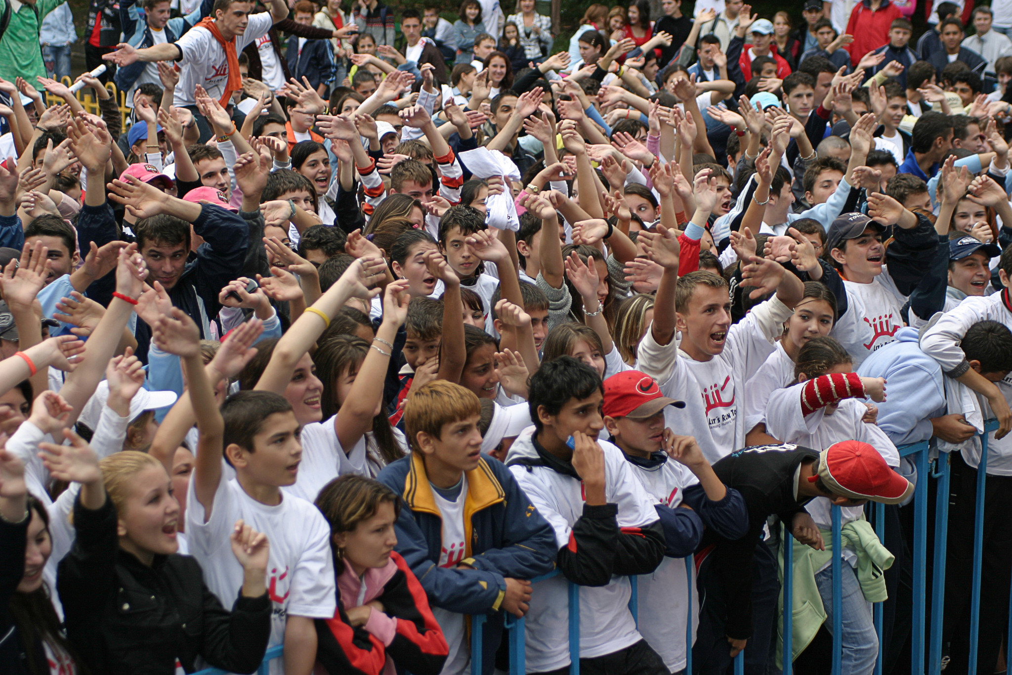
Show of hands
Notes:
NOTE: Gathering demographic information helps owasp to increase sponsorship please pass what you learn onto Paul.Ritchie@owasp.org.
Now that you know a bit about OWASP, we would like to know a bit about you. Demographics from developers to CIO's are important to highlight as the community has many people that make it successful. By show of hands:
First OWASP Meeting, Event, Conference?
Volunteer Project Leaders?
Volunteer Chapter Leaders?
Commercial
Government
Developers?
Architects?
Pen-testers?
CIO's?
Question
Has the OWASP Foundation provided your corporation or professional value with guides, tools and community?

Slide 26

16
Years of community service
Notes:
17 Years YOUNG is the collective group. We have many groups popping up around us like IEEE, BSides, ISSA, ISACA, ISC2, Defcon, 2600 etc... we share one common bond - community. (Jan 2001-Current)
What will software look like in 20 years?

Slide 27

OWASP's DNA
Notes:
OWASP values people over profits.
And we derive our core values from this DNA. OWASP's Core Values are:
OPEN Everything at OWASP is radically transparent from our finances to our code.
INNOVATION OWASP encourages and supports innovation/experiments for solutions to software security challenges.
GLOBAL OWASP is inclusive not exclusive. Anyone around the world is free to participate in the OWASP community.
INTEGRITY OWASP is an honest and truthful, vendor agnostic, global community.

Slide 28
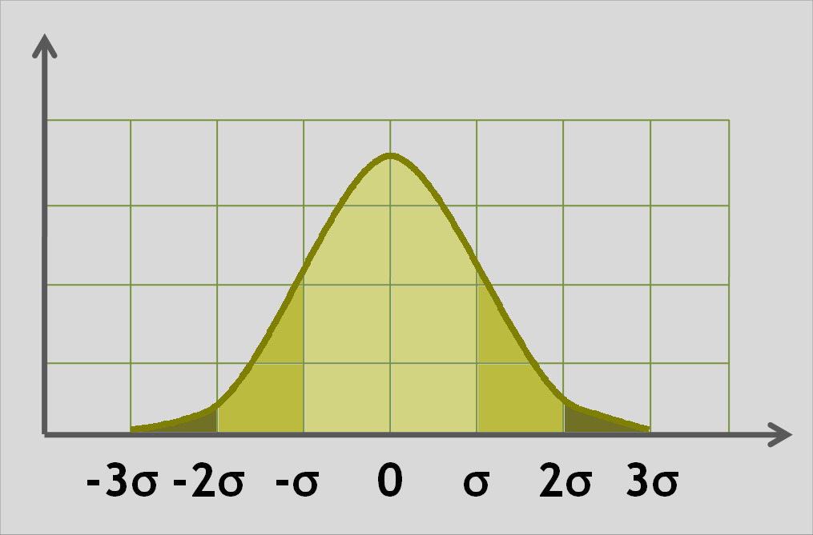
OWASP
by the numbers
Notes:
NOTES TO SPEAKER:
Slides 5-19 are intended to be gone through quickly.
This is why there are limited speaker notes.
The speaker is free to comment about each of the slides / ideas as the speaker chooses.

Slide 29

2,611,000
owasp.org page views (per month)
Notes:
Thanks to Javascipt and Google Analytics ;)
2013: 1,370,000

Slide 30
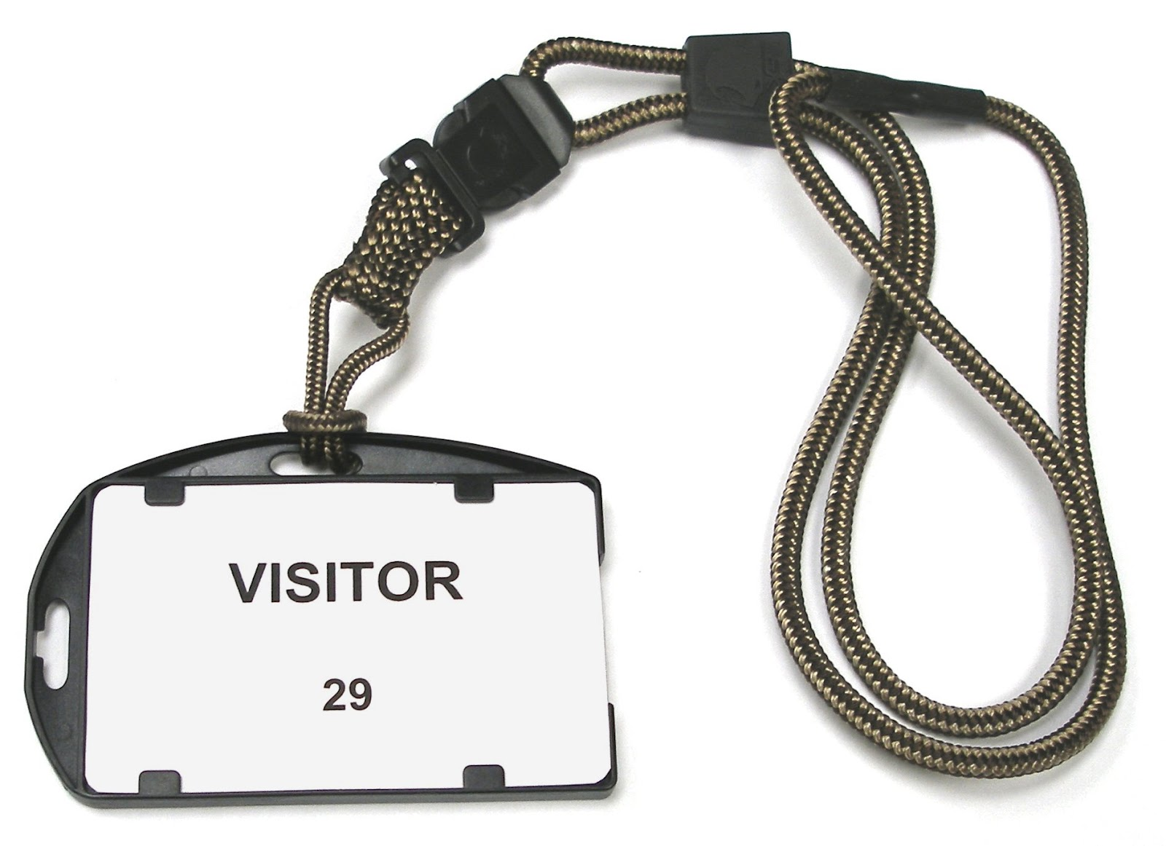
1,447,000
owasp.org unique visitors per month
Notes:
2013: 400,100

Slide 31
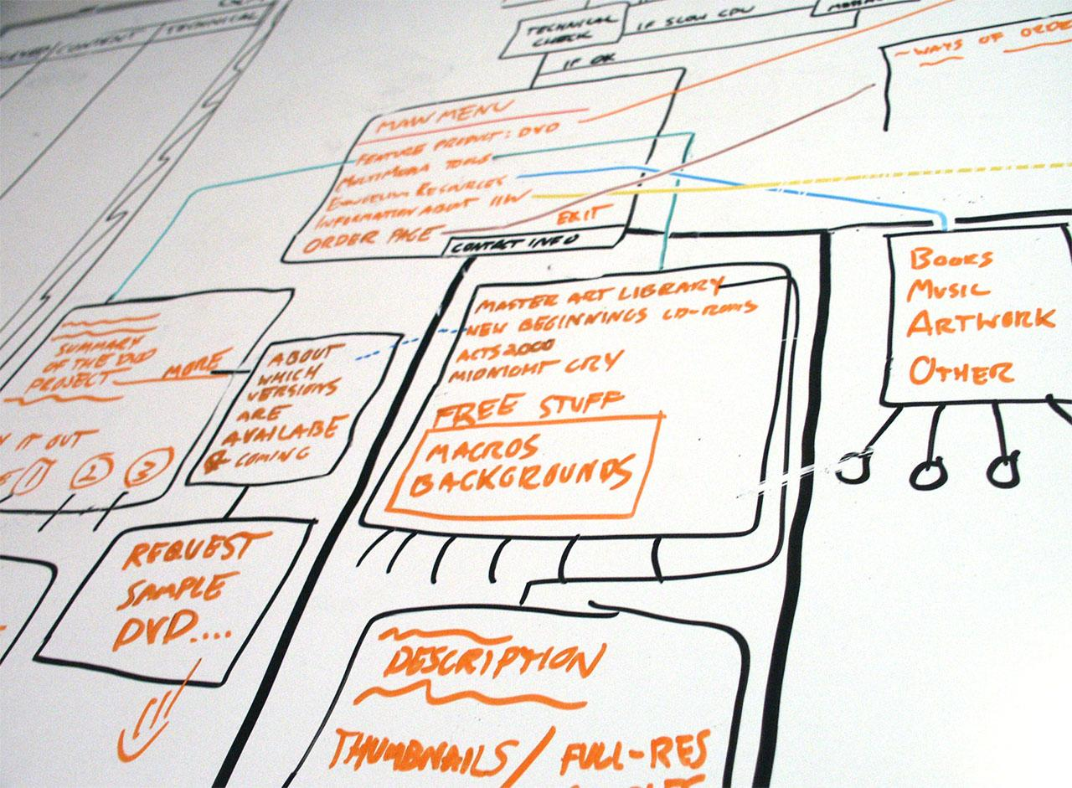
126
Active Projects
Notes:
From Johana’s 2015 report as of March.
Current Active Projects: 126
Incubator - 97
Labs - 26
Flagship - 3
Projects by Type:
19 Code projects
40 Documentation Projects
53 Tool Projects

Slide 32
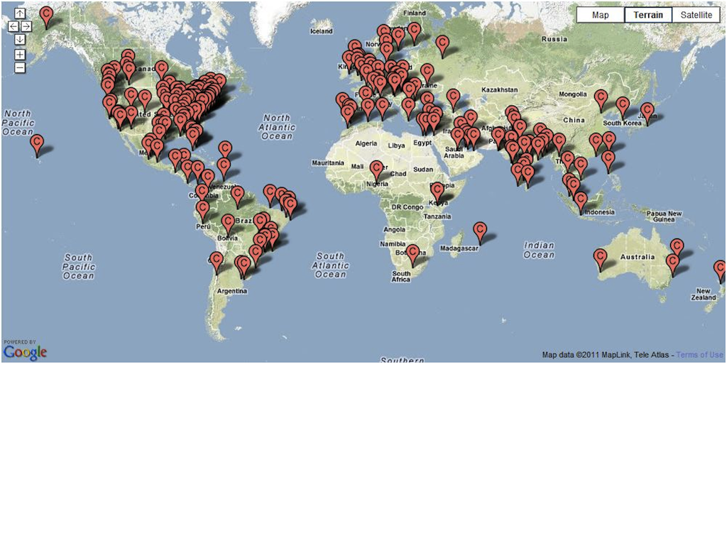
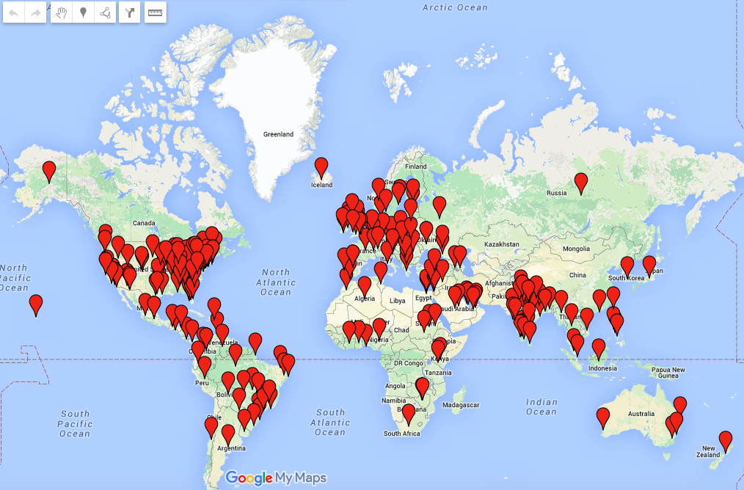
268
Active Chapters
Notes:
From Sarah’s roll-up report August 11 2013.
New Chapters August 2013: 1
Azerbaijan (Middle East) - lead by Adil Aliyev
How many countries?
as of 4/2/2015
102 as of 10/30/2013

Slide 33

44,000+
participants mailing lists
Notes:
Updated to 36k - TJB 19-Feb
2013: 43,000
ye2014: 44,000

Slide 34

129+
Government & Industry Citations!
Notes:
Does Industry & Government think our materials are creditable?
NOTE: pick a few that you find interesting, (delete the rest) no need to name them all...
Canadian Cyber Incident Response Centre, Center for Internet Security (CIS), Centre for the Protection of National Infrastructure (CPNI), Cloud Security Alliance (CSA), Defense Information Systems Agency (DISA), European Network and Information Security Agency (ENISA), Federal Financial Institutions Examination Council (FFIEC), Federal Trade Commission (FTC), Financial Services Roundtable, GovCertUK, Institute of Electrical and Electronics Engineers (IEEE), International Organization for Standardization (ISO) and International Electrotechnical Commission (IEC), National Cyber Security Division, National Institute of Standards and Technology (NIST), National Security Agency/Central Security Service, Payment Card Industry Security Standards Council (PCI SSC), SANS Institute, Software Engineering Institute (SEI), Trusted Information Sharing Network for Critical Infrastructure Protection (TISN), World Wide Web Consortium (W3C), Australian Computer Emergency Response Team (AusCERT), Canadian Cyber Incident Response Centre, Combined Security Incident Response Team (CSIRTUK), Information Assurance Technology Analysis Center (IATAC), Data and Analysis Center for Software (DACS).
And in September the Department of Homeland Security (DHS)!
88 as of 2013
126 as of 03/31/2015
Source:
https://www.owasp.org/index.php/Industry:Citations

Slide 35

9
Academic Supporters
Notes:
Are you a alumni? Do you give back to your college - bring them OWASP via or Academic Supporters program. Academics supporters provide space for chapter or student chapter meetings and provide feedback on our educational materials as well as conversation around application security curriculum development.
We are currently revising our Academic Supporters program. In the past we have had over 100 universities and schools listed as academic supporters.
8 reported active/confirmed as of 3/31/2015

Slide 36

55
Paid Corporate Memberships
Notes:
Corporate Supporters -- Industry providers such as UPS, BestBuy, HP, Oracle, Twitter, and many technology service providers including Rackspace thank you for hosting the website btw (count from https://www.owasp.org/index.php/Main_Page)
Source: https://www.owasp.org/index.php/February_2015_Membership_Report

Slide 37
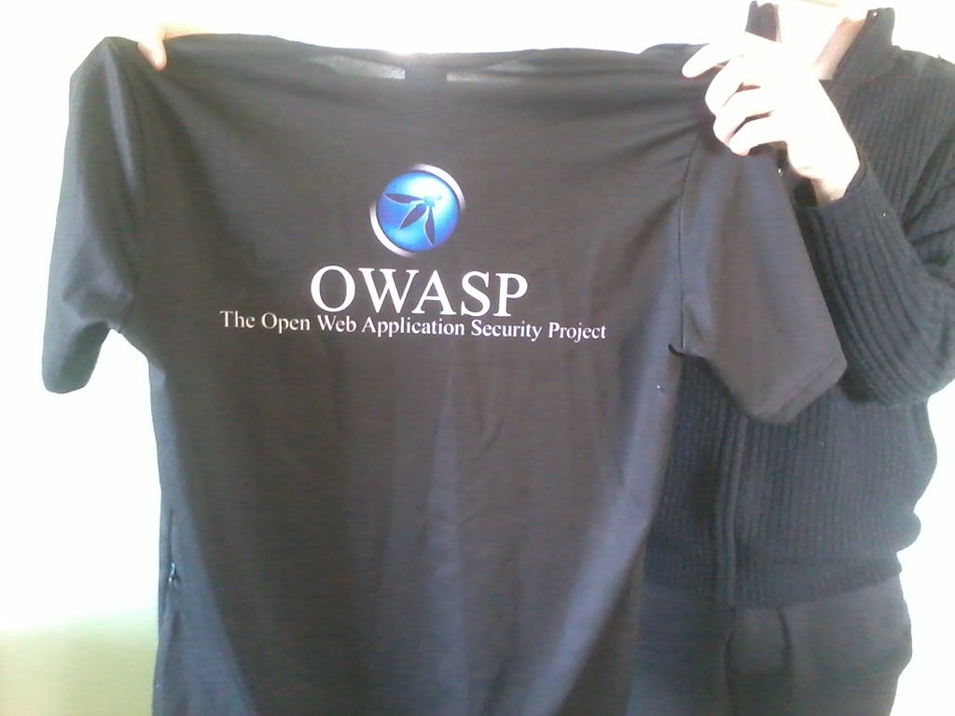
2268
Individual Members
Notes:
http://owasp.com/index.php/July_2013_Membership_Report

Slide 38

Contact Us
support@owasp.org
www.owasp.org
Notes:
This event is more than a bunch of speakers presenting slides you should see this in the hallways and after the sessions are over. People sitting down to
work together on projects big and small. If your like the rest of us, you don't need more email so take the time to introduce yourself and provide feedback.

Slide 39
OWASP Top 10
A1: Injection
A4: Insecure Direct Object References
A2:Broken Authentication and Session Management
A10: Unvalidated Redirects and Forwards
A3: Cross-Site Scripting (XSS)
A7: Missing Function Level Access Control
A5:Security Misconfiguration
A6: Sensitive Data Exposure
A8: Cross Site Request Forgery (CSRF)
A9: Using Components with known vulnerabilities

Slide 40
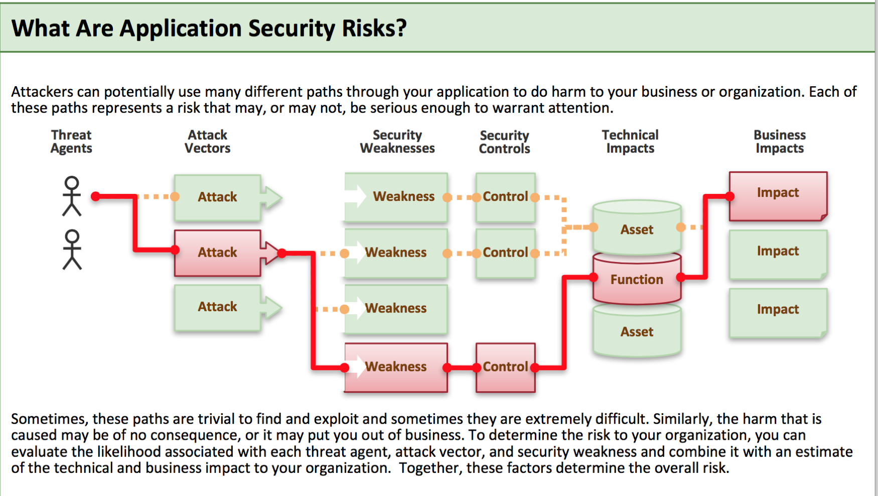

Slide 41
A1 – Injection
Injection means…
Tricking an application into including unintended commands in the data sent to an interpreter
Interpreters…
Take strings and interpret them as commands
SQL, OS Shell, LDAP, XPath, Hibernate, etc…
SQL injection is still quite common
Many applications still susceptible (really don’t know why)
Even though it’s usually very simple to avoid
Typical Impact
Usually severe. Entire database can usually be read or modified
May also allow full database schema, or account access, or even OS level access

Slide 42
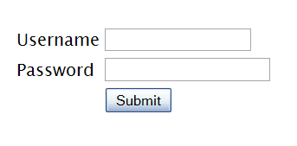
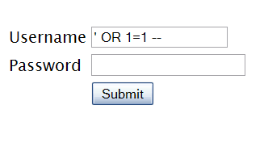

"SELECT * FROM accounts WHERE acct=‘’ OR 1=1--’"
Account Summary
Acct:5424-6066-2134-4334
Acct:4128-7574-3921-0192
Acct:5424-9383-2039-4029
Acct:4128-0004-1234-0293
Account:
Account:
SKU:
DB Table 

SKU:
HTTP response 

HTTP request
Finance
SQL query
Transactions
Accounts
Administration
Communication
Knowledge Mgmt
E-Commerce
Bus. Functions
Databases
Legacy Systems
Web Services
Directories
Billing
Application Layer
Human Resrcs
APPLICATION ATTACK
Custom Code
1. Application presents a form to the attacker
2. Attacker sends an attack in the form data
App Server
3. Application forwards attack to the database in a SQL query
Web Server
Hardened OS
4. Database runs query containing attack and sends encrypted results back to application
Network Layer
Firewall
Firewall
5. Application decrypts data as normal and sends results to the user
Notes:
Main Point
The flow of a SQL injection attack goes from attacker to application to database, then back.
Teaching Points
SQL injection is a simple attack that exploits the trust relationship between the database and the application. In essence, the attacker tricks the application into sending the wrong query to the database. The database trusts the application, and so complies with the request.
Even if the data is encrypted in the database, this type of attack can access the data. In the example depicted above, the attacker sends an attack in the data that tricks the database into returning all the credit cards from the database instead of only one. Normally, the application would decrypt the account owner’s credit card number (or other sensitive data) and display it. When attacked, the application decrypts all the card numbers and displays them all to the attacker.
Examples, Demonstrations, Stories, Notes

Slide 43
A1 – Avoid Injection Flaws
Recommendations
Avoid the interpreter entirely, or
Use an interface that supports bind variables (e.g., prepared statements, or stored procedures),
Bind variables allow the interpreter to distinguish between code and data
Encode all user input before passing it to the interpreter
Always perform ‘white list’ input validation on all user supplied input
Always minimize database privileges to reduce the impact of a flaw
References
For more details, read the new http://www.owasp.org/index.php/SQL_Injection_Prevention_Cheat_Sheet

Slide 44
A2 – Broken Authentication and Session Management
HTTP is a “stateless” protocol
Means credentials have to go with every request
Should use SSL for everything requiring authentication
Session management flaws
SESSION ID used to track state since HTTP doesn’t
and it is just as good as credentials to an attacker
SESSION ID is typically exposed on the network, in browser, in logs, …
Beware the side-doors
Change my password, remember my password, forgot my password, secret question, logout, email address, etc…
Typical Impact
User accounts compromised or user sessions hijacked

Slide 45
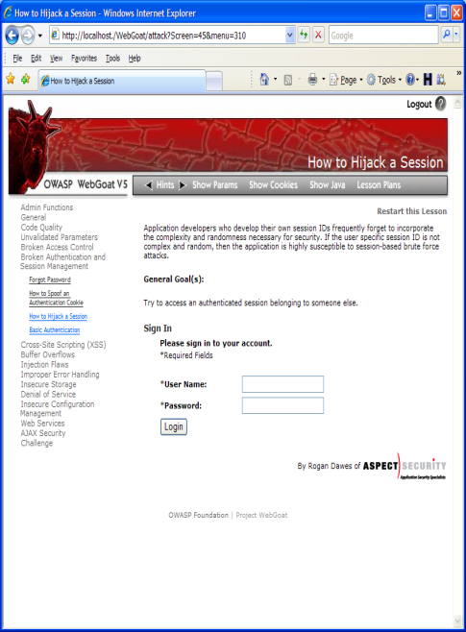

1
User sends credentials
Finance
Transactions
Accounts
Administration
Communication
Knowledge Mgmt
E-Commerce
www.boi.com?JSESSIONID=9FA1DB9EA...
Bus. Functions
Site uses URL rewriting
(i.e., put session in URL)
2
Custom Code
3
User clicks on a link to http://www.hacker.com in a forum
Hacker checks referer logs on www.hacker.com
and finds user’s JSESSIONID
4
5
Hacker uses JSESSIONID and takes over victim’s account

Slide 46
A2 – Avoiding Broken Authentication and Session Management
Verify your architecture
Authentication should be simple, centralized, and standardized
Use the standard session id provided by your container
Be sure SSL protects both credentials and session id at all times
Verify the implementation
Forget automated analysis approaches
Check your SSL certificate
Examine all the authentication-related functions
Verify that logoff actually destroys the session
Use OWASP’s WebScarab to test the implementation

Slide 47
A3 – Cross-Site Scripting (XSS)
Occurs any time…
Raw data from attacker is sent to an innocent user’s browser
Raw data…
Stored in database
Reflected from web input (form field, hidden field, URL, etc…)
Sent directly into rich JavaScript client
Virtually every web application has this problem
Try this in your browser – javascript:alert(document.cookie)
Typical Impact
Steal user’s session, steal sensitive data, rewrite web page, redirect user to phishing or malware site
Most Severe: Install XSS proxy which allows attacker to observe and direct all user’s behavior on vulnerable site and force user to other sites

Slide 48
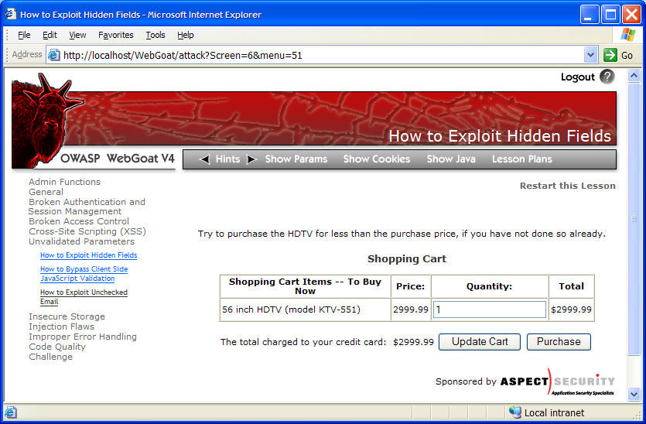
Cross-Site Scripting Illustrated
1
Attacker sets the trap – update my profile
Application with stored XSS vulnerability
Attacker enters a malicious script into a web page that stores the data on the server
2
Victim views page – sees attacker profile
Finance
Transactions
Accounts
Administration
Communication
Knowledge Mgmt
E-Commerce
Bus. Functions
Custom Code
Script runs inside victim’s browser with full access to the DOM and cookies
3
Script silently sends attacker Victim’s session cookie

Slide 49
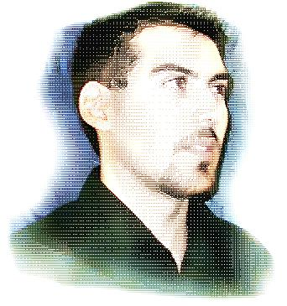
A3 – Avoiding XSS Flaws
Recommendations
Eliminate Flaw
Don’t include user supplied input in the output page
Defend Against the Flaw
Primary Recommendation: Output encode all user supplied input
(Use OWASP’s ESAPI to output encode:
http://www.owasp.org/index.php/ESAPI
Perform ‘white list’ input validation on all user input to be included in page
For large chunks of user supplied HTML, use OWASP’s AntiSamy to sanitize this HTML to make it safe
See: http://www.owasp.org/index.php/AntiSamy
References
For how to output encode properly, read the new http://www.owasp.org/index.php/XSS_(Cross Site Scripting) Prevention Cheat Sheet
(AntiSamy)

Slide 50
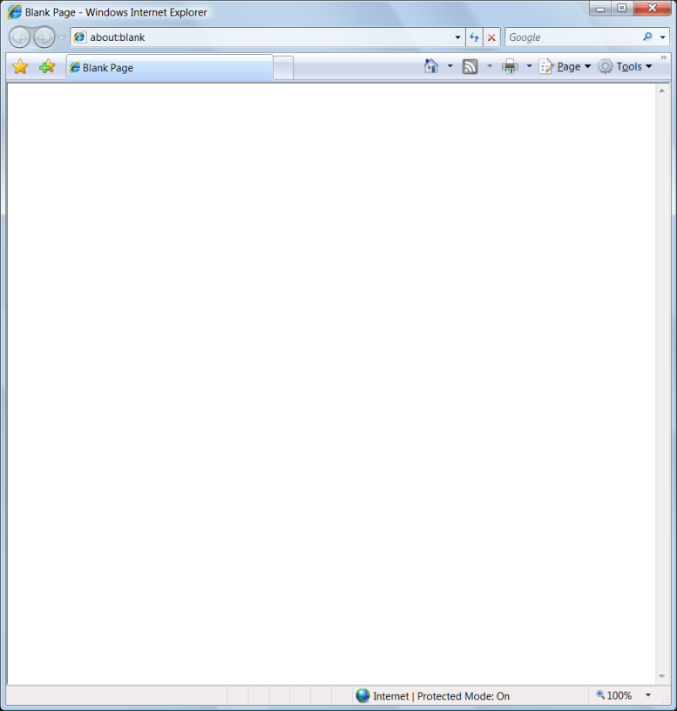
Safe Escaping Schemes in Various HTML Execution Contexts
#1: ( &, <, >, " ) → &entity; ( ', / ) → &#xHH;
ESAPI: encodeForHTML()
HTML Element Content
(e.g., <div> some text to display </div> )
#2: All non-alphanumeric < 256 → &#xHH
ESAPI: encodeForHTMLAttribute()
HTML Attribute Values
(e.g., <input name='person' type='TEXT' value='defaultValue'> )
#3: All non-alphanumeric < 256 → \xHH
ESAPI: encodeForJavaScript()
JavaScript Data
(e.g., <script> some javascript </script> )
#4: All non-alphanumeric < 256 → \HH
ESAPI: encodeForCSS()
HTML Style Property Values
(e.g., .pdiv a:hover {color: red; text-decoration: underline} )
#5: All non-alphanumeric < 256 → %HH
ESAPI: encodeForURL()
URI Attribute Values
(e.g., <a href="javascript:toggle('lesson')" )
ALL other contexts CANNOT include Untrusted Data
Recommendation: Only allow #1 and #2 and disallow all others
See: www.owasp.org/index.php/XSS_(Cross_Site_Scripting)_Prevention_Cheat_Sheet for more details
Notes:
Main Point
There are many escaping schemes supported in different elements of the browser.
Teaching Points
In order to defend against XSS, you need to escape all user supplied input using the proper escaping scheme before you include that input in that part of the page.
Each HTML execution context needs its own escaping scheme based on how the spec for that context defines how it handles character escaping.
ESAPI has an encoder for each of these contexts. They are:
encodeForHTML()
encodeForHTMLAttribute()
encodeForJavaScript()
encodeForCSS()
encodeForURL()
In each context you need to prevent certain dangerous characters if you can’t eliminate all user input to that context
HTML Elements – [This is simply the text on the page] – Defense against this is the big 5, because that prevents the introduction of close tags to break out of the Element (e.g., </div> or </span> or the introduction of script tags (<script) )
HTML Attributes – Content inside the quotes is inert, so preventing the introduction of single or double quotes is key. Typically encoding the big 5 ( &, ', ", <, >) is strongly recommended. Also encoding # is usually a good idea.
JavaScript Data – This context is executable in its own right, and therefore inherently dangerous. Ideally, you would not include user supplied input here ever. Otherwise, only input validation can really do anything to help you as output encoding is not sufficient.
HTML Style Properties (CSS) – This is very dangerous as it will execute content supplied – to prevent a breakout, you need to dissallow '}', but that may not be sufficient since content inside the brace can execute as well. Ideally, you would not include user supplied input here ever. Otherwise, only input validation can really do anything to help you as output encoding is not sufficient.
URI Attributes - This is very dangerous as it will (decode and) execute content supplied – to prevent a breakout, you need to dissallow ' " ', but that may not be sufficient since content inside the quotes can execute as well.
Examples, Demonstrations, Stories, Notes
See the page at OWASP for the full and latest details!!

Slide 51
A4 – Insecure Direct Object References
How do you protect access to your data?
This is part of enforcing proper “Authorization”, along with A7 – Failure to Restrict URL Access
A common mistake …
Only listing the ‘authorized’ objects for the current user, or
Hiding the object references in hidden fields
This is called presentation layer access control, and doesn’t work
Attacker simply tampers with parameter value
Typical Impact
Users are able to access unauthorized files or data
… and then not enforcing these restrictions on the server side

Slide 52
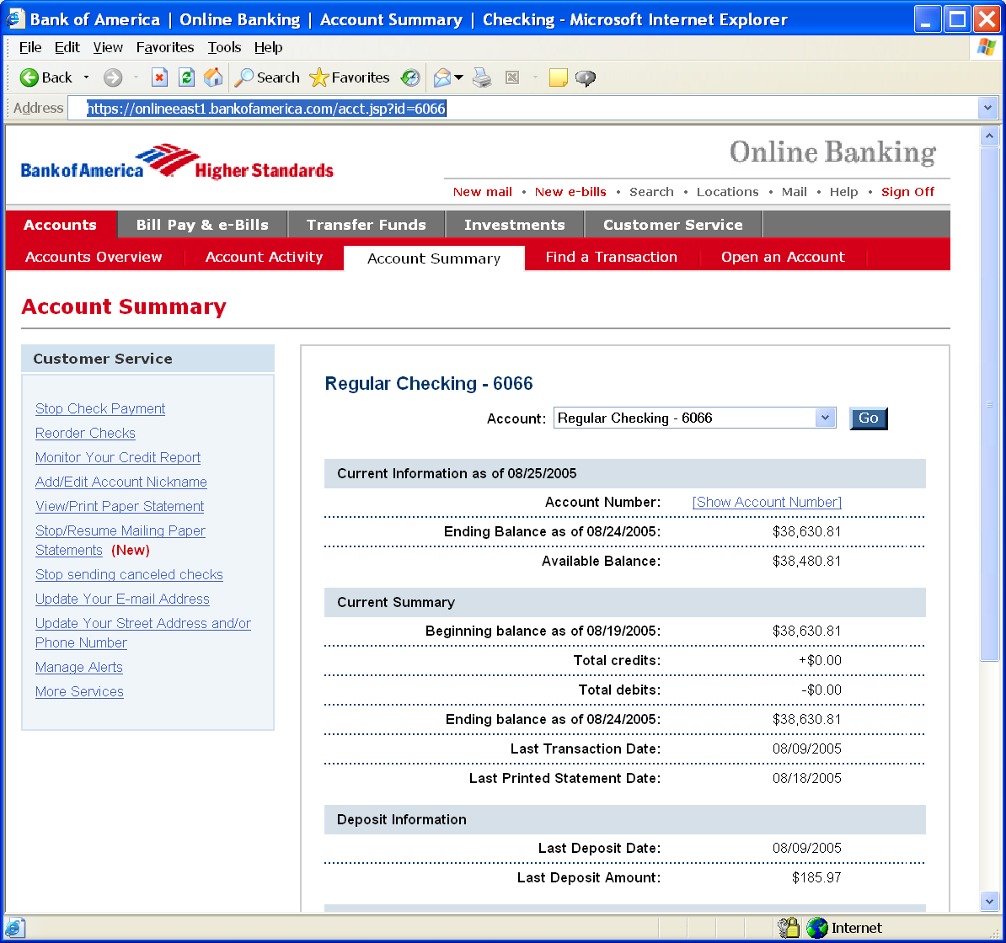
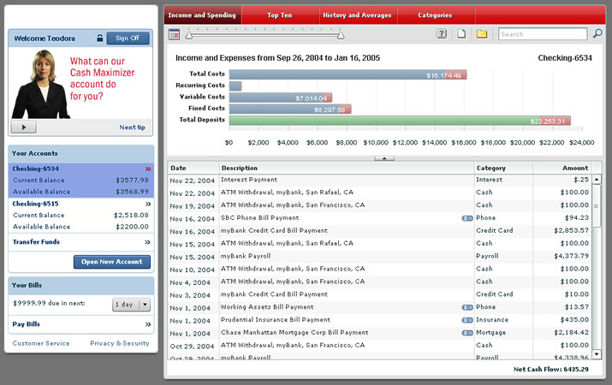
Insecure Direct Object References
Attacker notices his acct parameter is 6065
?acct=6065
He modifies it to a nearby number
?acct=6066
Attacker views the victim’s account information
https://www.onlinebank.com/user?acct=6065
Notes:
Main Point
Here’s a concrete example of an access control problem to ensure that everyone understands what access control means.
Teaching Points
In this example, the attacker is simply manipulating the account id on the URL. The application should be getting the user’s account from a trustworthy source, not the user’s request.
There are many variations of this kind of attack. Many times they are not this obvious, relying on a hidden field, cookie, or header to make the access control decision. But the root cause is the same – never rely on anything from the user when making an access control decision.
Examples, Demonstrations, Stories
A healthcare application that processes xray and other medical imagery recently had this issue. They set a cookie called “privLevel” and used it to determine which functions to display. When we changed it from 4 to 10, we were given an administrator menu and could access many powerful unauthorized functions.

Slide 53
A4 – Avoiding Insecure Direct Object References
Eliminate the direct object reference
Replace them with a temporary mapping value (e.g. 1, 2, 3)
ESAPI provides support for numeric & random mappings
IntegerAccessReferenceMap & RandomAccessReferenceMap
Validate the direct object reference
Verify the parameter value is properly formatted
Verify the user is allowed to access the target object
Query constraints work great!
Verify the requested mode of access is allowed to the target object (e.g., read, write, delete)
http://app?file=Report123.xls
Access
Reference
Map
Report123.xls
http://app?file=1
http://app?id=9182374
Acct:9182374
http://app?id=7d3J93

Slide 54
A5 – Security Misconfiguration
Web applications rely on a secure foundation
All through the network and platform
Don’t forget the development environment
Is your source code a secret?
Think of all the places your source code goes
Security should not require secret source code
CM must extend to all parts of the application
All credentials should change in production
Typical Impact
Install backdoor through missing network or server patch
XSS flaw exploits due to missing application framework patches
Unauthorized access to default accounts, application functionality or data, or unused but accessible functionality due to poor server configuration

Slide 55
Security Misconfiguration Illustrated
Finance
Database
Transactions
Accounts
Administration
Communication
Knowledge Mgmt
E-Commerce
Bus. Functions
Custom Code
App Configuration
Framework
Development
App Server
Web Server
QA Servers
Insider
Hardened OS
Test Servers
Source Control

Slide 56
A5 – Avoiding Security Misconfiguration
Verify your system’s configuration management
Secure configuration “hardening” guideline
Automation is REALLY USEFUL here
Must cover entire platform and application
Keep up with patches for ALL components
This includes software libraries, not just OS and Server applications
Analyze security effects of changes
Can you “dump” the application configuration
Build reporting into your process
If you can’t verify it, it isn’t secure
Verify the implementation
Scanning finds generic configuration and missing patch problems

Slide 57
A6 – Sensitive Data Exposure
Storing and transmitting sensitive data insecurely
Failure to identify all sensitive data
Failure to identify all the places that this sensitive data gets stored
Databases, files, directories, log files, backups, etc.
Failure to properly protect this data in every location
Typical Impact
Attackers access or modify confidential or private information
Attackers extract secrets to use in additional attacks
Company embarrassment, customer dissatisfaction, and loss of trust
Expense of cleaning up the incident, such as forensics, sending apology letters, reissuing thousands of credit cards, providing identity theft insurance
Business gets sued and/or fined
e.g, credit cards, health care records, financial data (yours or your customers)
Failure to identify all the places that this sensitive data is sent
On the web, to backend databases, to business partners, internal communications
Notes:
(Insecure Cryptographic Storage & insecure channel protection)

Slide 58
A7 – Missing Function Level Access Control
How do you protect access to URLs (pages)?
Or functions referenced by a URL plus parameters ?
This is part of enforcing proper “authorization”, along with A4 – Insecure Direct Object References
A common mistake …
Displaying only authorized links and menu choices
This is called presentation layer access control, and doesn’t work
Attacker simply forges direct access to ‘unauthorized’ pages
Typical Impact
Attackers invoke functions and services they’re not authorized for
Access other user’s accounts and data
Perform privileged actions

Slide 59
Missing Function Level Access Control Illustrated
Attacker notices the URL indicates his role
/user/getAccounts
He modifies it to another directory (role)
/admin/getAccounts, or
/manager/getAccounts
Attacker views more accounts than just their own

Slide 60
Avoiding Missing Function Level Access Control
For function, a site needs to do 3 things
Restrict access to authenticated users (if not public)
Enforce any user or role based permissions (if private)
Completely disallow requests to unauthorized page types (e.g., config files, log files, source files, etc.)
Verify your architecture
Use a simple, positive model at every layer
Be sure you actually have a mechanism at every layer
Verify the implementation
Forget automated analysis approaches
Verify that each URL (plus any parameters) referencing a function is protected by
An external filter, like Java EE web.xml or a commercial product
Or internal checks in YOUR code
Verify the server configuration disallows requests to unauthorized file types
Use OWASP’s ZAP or your browser to forge unauthorized requests

Slide 61
A8 – Cross Site Request Forgery (CSRF)
Cross Site Request Forgery
An attack where the victim’s browser is tricked into issuing a command to a vulnerable web application
Vulnerability is caused by browsers automatically including user authentication data (session ID, IP address, Windows domain credentials, …) with each request
Imagine…
What if a hacker could steer your mouse and get you to click on links in your online banking application?
What could they make you do?
Typical Impact
Initiate transactions (transfer funds, logout user, close account)
Access sensitive data
Change account details
Notes:
Main Point
CSRF is essentially an attack that essentially allows the attacker to drive your (the victim’s) browser. Wouldn’t that be bad? Of course. Its REALLY bad.
Teaching Points
CSRF attacks primarily target functions that cause state to change on the application. I.e., modify or delete something, initiate a transaction, etc.
However, CSRF attacks can simply be used to access sensitive data, and then transfer that sensitive data to the attacker.
Examples, Demonstrations, Stories

Slide 62

CSRF Vulnerability Pattern
The Problem
Web browsers automatically include most credentials with each request
Even for requests caused by a form, script, or image on another site
All sites relying solely on automatic credentials are vulnerable!
(almost all sites are this way)
Automatically Provided Credentials
Session cookie
Basic authentication header
IP address
Client side SSL certificates
Windows domain authentication
Notes:
Main Point
CSRF is a big problem because browsers automatically send the user’s credentials and most sites rely solely on these automatically provided credentials.
Teaching Points
All this was, of course, done on purpose to make it easy to build web sites that track the user’s identity throughout the site.
No one thought that this level of automation could easily be abused to the attacker’s advantage.
Now we know this is problem, but how to fix it? See the rest of this section.
Examples, Demonstrations, Stories

Slide 63
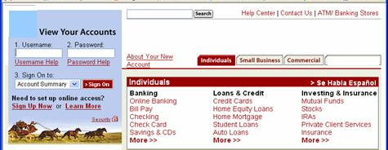
CSRF Illustrated
Attacker sets the trap on some website on the internet (or simply via an e-mail)
1
Application with CSRF vulnerability
Hidden <img> tag contains attack against vulnerable site
Finance
Transactions
Accounts
Administration
Communication
Knowledge Mgmt
E-Commerce
Bus. Functions
2
While logged into vulnerable site, victim views attacker site
Custom Code
3
Vulnerable site sees legitimate request from victim and performs the action requested
<img> tag loaded by browser – sends GET request (including credentials) to vulnerable site
Notes:
Main Point
This is how a CSRF attack works.
Teaching Points
1. Attacker lures victim to read some malicious content (in web site or e-mail)
2. Malicious request automatically sent to vulnerable site (if in IMG tag or something similar), or user might actually click on or submit something to initiate the request (i.e., phishing like attack).
3. IF THE CONDITIONS ARE RIGHT, then the malicious request will include the victim’s credentials when sent to the vulnerable site. If it works, the unauthorized transaction will be accepted, or the unauthorized request will return sensitive data to the attacker.
4. Regardless of success or failure of the attack, the attack itself is typically completely invisible to the potential victim.
Examples, Demonstrations, Stories

Slide 64
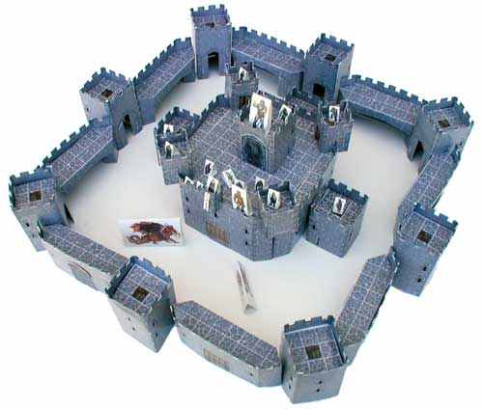
A8 – Avoiding CSRF Flaws
Add a secret, not automatically submitted, token to ALL sensitive requests
This makes it impossible for the attacker to spoof the request
(unless there’s an XSS hole in your application)
Tokens should be cryptographically strong or random
Options
Store a single token in the session and add it to all forms and links
Hidden Field: <input name="token" value="687965fdfaew87agrde" type="hidden"/>
Single use URL: /accounts/687965fdfaew87agrde
Form Token: /accounts?auth=687965fdfaew87agrde …
Beware exposing the token in a referer header
Hidden fields are recommended
Can have a unique token for each function
Use a hash of function name, session id, and a secret
Can require secondary authentication for sensitive functions (e.g., eTrade)
Don’t allow attackers to store attacks on your site
Properly encode all input on the way out
This renders all links/requests inert in most interpreters
See the new: www.owasp.org/index.php/CSRF_Prevention_Cheat_Sheet for more details
Notes:
Main Point
The only real solution is adding a secret token to each update command on a site.
Teaching Points
This token has to be stored in a location that is NOT automatically submitted with other requests by your browser. i.e., in a hidden field, or as another parameter.
Beware of including this token in the URL parameters, since it will get included in the referer field of future requests (thus exposing the token).
It would be ideal of a unique value was created for every single individual transaction, but that can be a pain to create.
Having a single unique value of the entire session would be way better than nothing, so we’d recommend you at least start with that.
Also, it is VERY IMPORTANT, that you not have XSS flaws on your site because such flaws can be used to steal or access your unique tokens and defeat any CSRF defense you put in place.
Examples, Demonstrations, Stories

Slide 65
Everyone Uses Vulnerable Libraries
29 MILLION vulnerable downloads in 2011
Libraries | 31
Library Versions | 1,261
Organizations | 61,807
Downloads | 113,939,358
https://www.aspectsecurity.com/news/press/the-unfortunate-reality-of-insecure-libraries
Notes:
This is why A9 was added to the OWASP Top 10 in 2013. Everyone uses vulnerable libraries and we need to get processes and tools in place to significantly reduce their use!!

Slide 66
A9 – Using Known Vulnerable Components
Vulnerable Components Are Common
Some vulnerable components (e.g., framework libraries) can be identified and exploited with automated tools
Widespread
Virtually every application has these issues because most development teams don’t focus on ensuring their components/libraries are up to date
Typical Impact
Full range of weaknesses is possible, including injection, broken access control, XSS ...
In many cases, the developers don’t even know all the components they are using, never mind their versions. Component dependencies make things even worse
This expands the threat agent pool beyond targeted attackers to include chaotic actors
The impact could range from minimal to complete host takeover and data compromise

Slide 67
What Can You Do to Avoid This?
Ideal
Use automation that checks periodically (e.g., every build) to see if your libraries are out of date
https://www.owasp.org/index.php/OWASP_Dependency_Check
Ensure the code of critical third-party libraries is reviewed by a security expert with each update
Could also

Slide 68
A10 – Unvalidated Redirects and Forwards
Web application redirects are very common
And frequently include user supplied parameters in the destination URL
If they aren’t validated, attacker can send victim to a site of their choice
Forwards (aka Transfer in .NET) are common too
They internally send the request to a new page in the same application
Sometimes parameters define the target page
If not validated, attacker may be able to use unvalidated forward to bypass authentication or authorization checks
Typical Impact
Redirect victim to phishing or malware site
Attacker’s request is forwarded past security checks, allowing unauthorized function or data access

Slide 69

Unvalidated Redirect Illustrated
1
Attacker sends attack to victim via email or webpage
From: Internal Revenue Service Subject: Your Unclaimed Tax Refund Our records show you have an unclaimed federal tax refund. Please click here to initiate your claim.
3
Application redirects victim to attacker’s site
2
Victim clicks link containing unvalidated parameter
Finance
Transactions
Accounts
Administration
Communication
Knowledge Mgmt
E-Commerce
Bus. Functions
Custom Code
Request sent to vulnerable site, including attacker’s destination site as parameter. Redirect sends victim to attacker site
Evil Site
4
Evil site installs malware on victim, or phish’s for private information
http://www.irs.gov/taxrefund/claim.jsp?year=2006& … &dest=www.evilsite.com

Slide 70
Unvalidated Forward Illustrated
1
Attacker sends attack to vulnerable page they have access to
Request sent to vulnerable page which user does have access to. Redirect sends user directly to private page, bypassing access control.
public void sensitiveMethod( HttpServletRequest request, HttpServletResponse response) {
try {
// Do sensitive stuff here.
...
}
catch ( ...
2
Application authorizes request, which continues to vulnerable page
Filter
3
Forwarding page fails to validate parameter, sending attacker to unauthorized page, bypassing access control
public void doPost( HttpServletRequest request, HttpServletResponse response) {
try {
String target = request.getParameter( "dest" ) );
...
request.getRequestDispatcher( target ).forward(request, response);
}
catch ( ...

Slide 71
A10 – Avoiding Unvalidated Redirects and Forwards
There are a number of options
Avoid using redirects and forwards as much as you can
If used, don’t involve user parameters in defining the target URL
If you ‘must’ involve user parameters, then either
Validate each parameter to ensure its valid and authorized for the current user, or
(preferred) – Use server side mapping to translate choice provided to user with actual target page
Defense in depth: For redirects, validate the target URL after it is calculated to make sure it goes to an authorized external site
Some thoughts about protecting Forwards
Ideally, you’d call the access controller to make sure the user is authorized before you perform the forward
Next best is to make sure that users who can access the original page are ALL authorized to access the target page.

Slide 72
Summary: How do you address these problems?
Develop Secure Code
Follow the best practices in OWASP’s Guide to Building Secure Web Applications
https://www.owasp.org/index.php/Guide
And the cheat sheets: https://www.owasp.org/index.php/Cheat_Sheets
Use OWASP’s Application Security Verification Standard as a guide to what an application needs to be secure
https://www.owasp.org/index.php/ASVS
Use standard security components and security frameworks that are a fit for your organization
Review Your Applications
Ensure experts, tools and services review your applications continuously for security issues early in your lifecycle!
Automate as much security review as you can and supplement that with expert review where needed
Review your applications yourselves following OWASP Guidelines
OWASP Code Review Guide: https://www.owasp.org/index.php/Code_Review_Guide
OWASP Testing Guide: https://www.owasp.org/index.php/Testing_Guide

Slide 73
References
Stuttard, D. Pinto, M. The Web Application Hacker’s Handbook Finding and Exploiting Security Flaws, 2nd Edition.
McGraw ,G. Hoglund, G. Exploiting Software How to Break Code.
Shiflett, C. HTTP Developer’s Handbook.
Paul,M. (ISC)2 Official (ISC)2 Guide to the CSSLP.
OWASP Foundation
OWASP Top 10 2013.

Slide 74


Michael Hidalgo John Vargas michael.hidalgo@owasp.org john.vargas@owasp.org
Q&A.

